Slide 1

CREDIT EDA ASSIGNMENT
BY
SNEHA SUDHA

Slide 2
Business Objectives
This case study aims to identify patterns which indicate if a client has difficulty paying their installments which may be used for taking actions such as denying the loan, reducing the amount of loan, lending (to risky applicants) at a higher interest rate, etc. This will ensure that the consumers capable of repaying the loan are not rejected. Identification of such applicants using EDA is the aim of this case study.
Dataset Provided to Analyse:
1. 'application_data.csv' contains all the information of the client at the time of application.
The data is about whether a client has payment difficulties.
2. 'previous_application.csv' contains information about the client’s previous loan data. It contains the data whether the previous application had been Approved, Cancelled, Refused or Unused offer.

Slide 3
Data Cleaning Approach:
Checked the missing value percentage for all the columns in the dataset and dropped the columns which have 45% and above missing value percentage.
Imputed the relevant columns:
For categorical variable – imputed with mode value
For numerical variable – imputed with median if the variable has outliers, else impute with mean value.
Find columns which have outliers.
Univariant outliers – we can delete that row
Multivariant outliers – we can follow binning.
Checked datatypes of columns and corrected.
Identified that imbalance percentage is high on target variable. Hence, Split the data based on target variable and proceeded with the analysis.

Slide 4
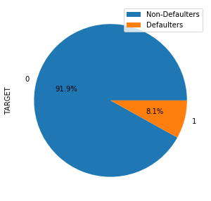
Target Variable
Imbalanced proportion found.
8.1% of total variable are defaulters

Slide 5
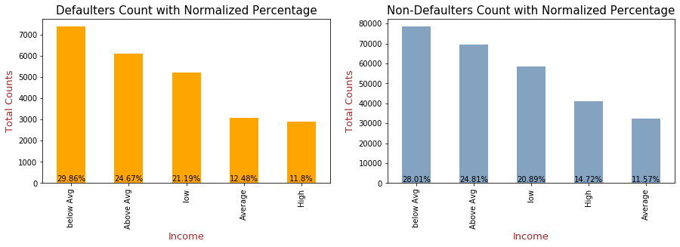
Total Income Vs Target
Most clients belong to below average and above average category
Clients belonging to below avg or low income category likely belong to defaulters
Best to choose the high and above avg category income group

Slide 6
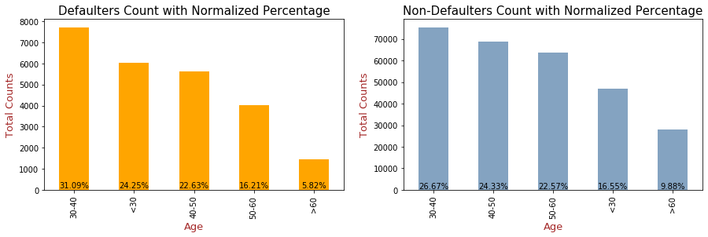
Age Vs Target
Clients between 30-50 age group mostly avail loans
20-40 age group is mostly belong to defaulter
Better to choose 40 years above clients.

Slide 7
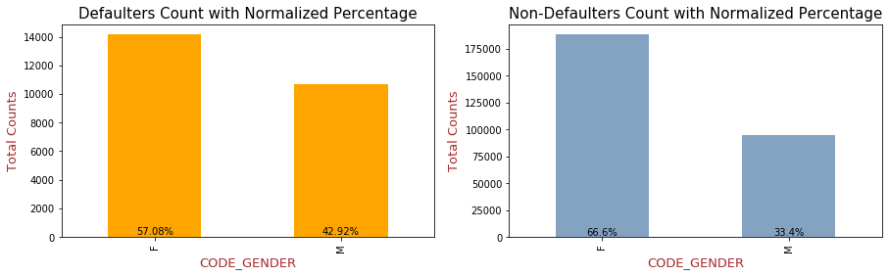
Gender Vs Target
Females are mostly taking loans
Males are mostly belongs to defaulters
Female group has high repayment percentage.

Slide 8
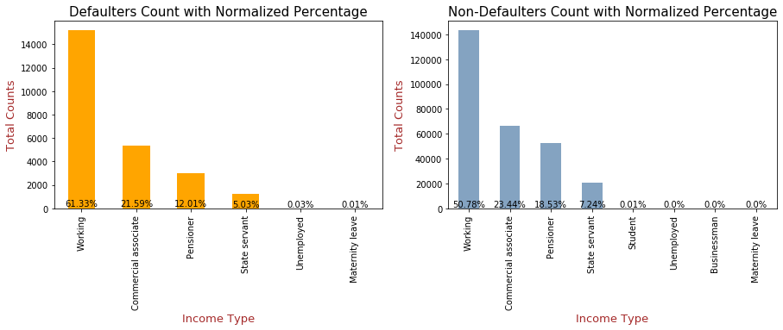
Income Type Vs Target
Working category people are mostly taking loans and they are mostly belongs to defaulters.
Even though the counts are very less to compare, but student and businessman categories are not present in defaulter list.
Pensioner is a good option to choose to provide loans.

Slide 9
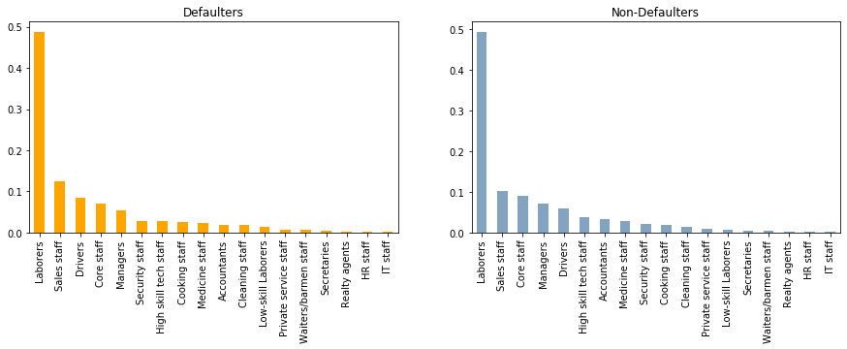
Occupation Type Vs Target
Laborers are mostly taking loan.
Limited datapoints to come up with further insights.

Slide 10
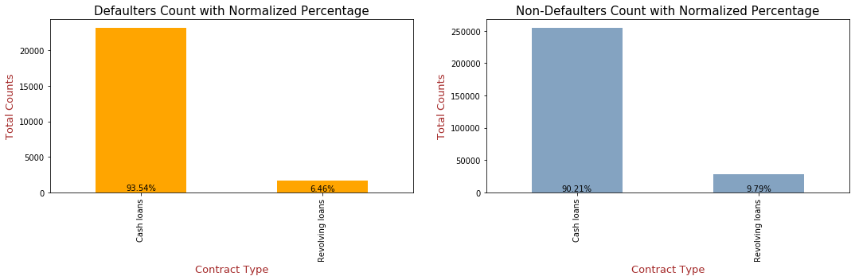
Contract Type Vs Target
Most people are choosing cash loans as contract type.
Most of the cash loaners are belonging to defaulters.

Slide 11
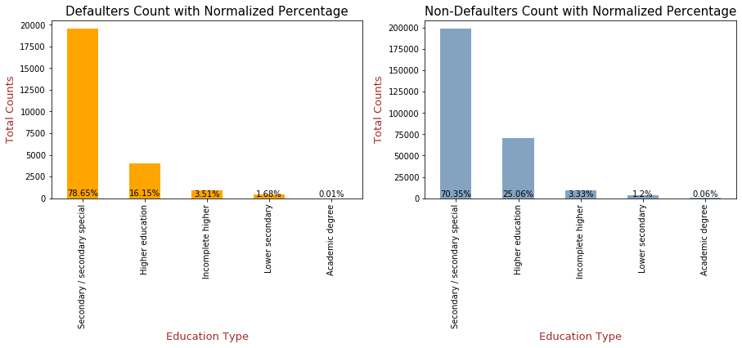
Education Type Vs Target
Most of the clients have completed secondary educations.
Defaulters are higher in secondary education and other lower education groups.
Its better to approve loan for higher educated clients.

Slide 12
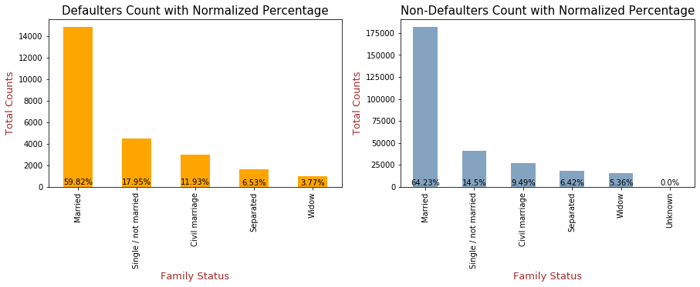
Family Status Vs Target
Married people mostly taking loans.
Single people mostly belong to defaulters.

Slide 13
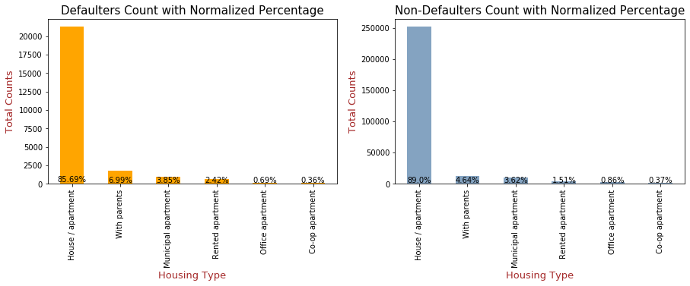
Housing Type Vs Target
People having house/apartments mostly taking loans.
People with parents are belonging to defaulters

Slide 14
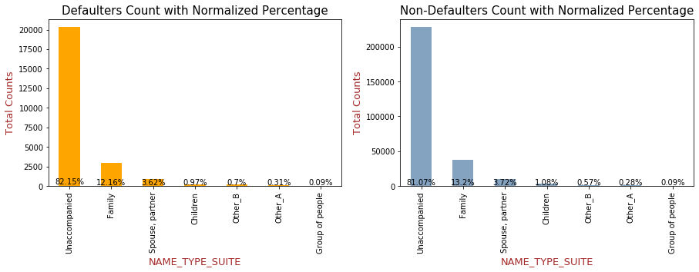
Name Type Suite Vs Target
Limited datapoints to come up with further insights.

Slide 15
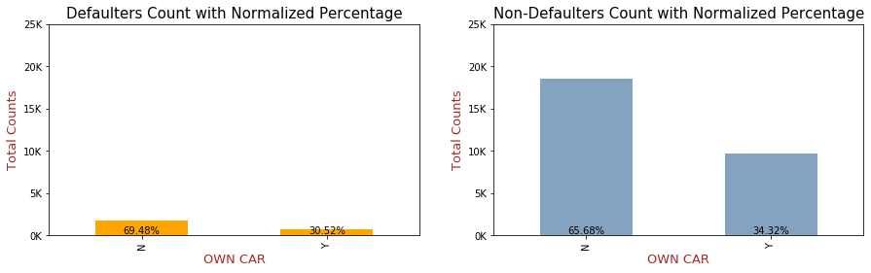
Own Car Vs Target
People without car is mostly taking loans.
People with car mostly belong to Non-defaulters

Slide 16
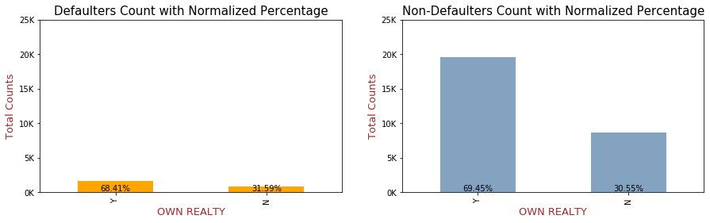
Own Realty Vs Target
People with Realty is mostly taking loans.
People with Realty mostly belong to Non-defaulters.

Slide 17
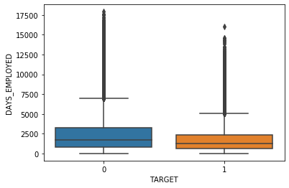
Days Employed Vs Target
Better to choose clients having high working experience
Freshers mostly belong to defaulters

Slide 18
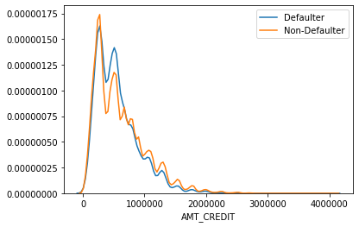
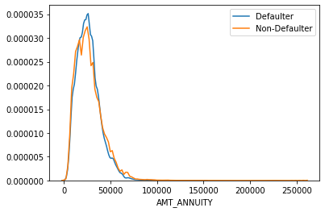
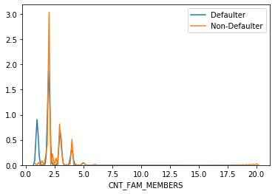
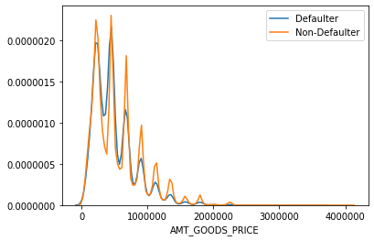
Numerical Variables
More people taking loans belong to low goods price, low annuity and low credits
Count of family members - Limited datapoints to come up with further insights.

Slide 19
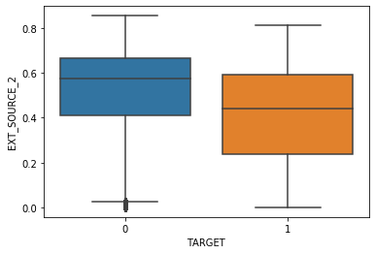
External Score Vs Target
People with more external score are less defaulted.

Slide 20
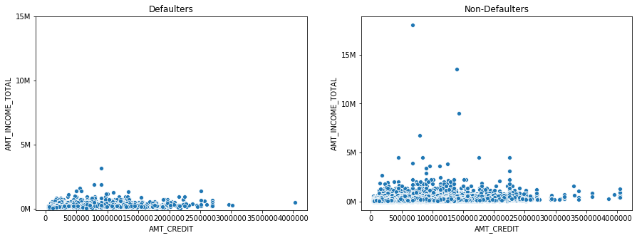
Amt credit Vs Total Income Vs Target
Mostly low income group are belonging to defaulters segment.
Non-Defaulter have more spread for income and credit.
Group having above 2.5M income and having credit above 25M have higher repayment ability.

Slide 21
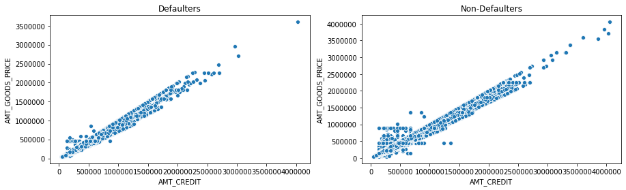
Amt credit Vs Goods Price Vs Target
AMT_CREDIT and AMT_GOODS_PRICE has a good linear relationship- when good price increases credit amount also increasing.
Group having above 20L goods price have higher repayment ability.

Slide 22
Top correlation
Defaulter Segment
Non-Defaulter Segment
DAYS_BIRTH_YEAR | DAYS_BIRTH | 0.999691
OBS_60_CNT_SOCIAL_CIRCLE | OBS_30_CNT_SOCIAL_CIRCLE | 0.998269
AMT_GOODS_PRICE | AMT_CREDIT | 0.982783
REGION_RATING_CLIENT_W_CITY | REGION_RATING_CLIENT | 0.956637
CNT_FAM_MEMBERS | CNT_CHILDREN | 0.885484
DEF_60_CNT_SOCIAL_CIRCLE | DEF_30_CNT_SOCIAL_CIRCLE | 0.868994
LIVE_REGION_NOT_WORK_REGION | REG_REGION_NOT_WORK_REGION | 0.847885
LIVE_CITY_NOT_WORK_CITY | REG_CITY_NOT_WORK_CITY | 0.77854
AMT_GOODS_PRICE | AMT_ANNUITY | 0.752295
AMT_ANNUITY | AMT_CREDIT | 0.752195
DAYS_BIRTH_YEAR | DAYS_EMPLOYED | 0.582441
DAYS_EMPLOYED | DAYS_BIRTH | 0.582185
AMT_ANNUITY | AMT_CREDIT | 0.752195
DAYS_BIRTH_YEAR | DAYS_EMPLOYED | 0.582441
DAYS_EMPLOYED | DAYS_BIRTH | 0.582185
DAYS_BIRTH_YEAR | DAYS_BIRTH | 0.999711
OBS_60_CNT_SOCIAL_CIRCLE | OBS_30_CNT_SOCIAL_CIRCLE | 0.998508
AMT_GOODS_PRICE | AMT_CREDIT | 0.987022
REGION_RATING_CLIENT_W_CITY | REGION_RATING_CLIENT | 0.950149
CNT_FAM_MEMBERS | CNT_CHILDREN | 0.878571
LIVE_REGION_NOT_WORK_REGION | REG_REGION_NOT_WORK_REGION | 0.861861
DEF_60_CNT_SOCIAL_CIRCLE | DEF_30_CNT_SOCIAL_CIRCLE | 0.859332
LIVE_CITY_NOT_WORK_CITY | REG_CITY_NOT_WORK_CITY | 0.830381
AMT_GOODS_PRICE | AMT_ANNUITY | 0.776421
AMT_ANNUITY | AMT_CREDIT | 0.771297
DAYS_EMPLOYED | DAYS_BIRTH | 0.626114
DAYS_BIRTH_YEAR | DAYS_EMPLOYED | 0.626028

Slide 23
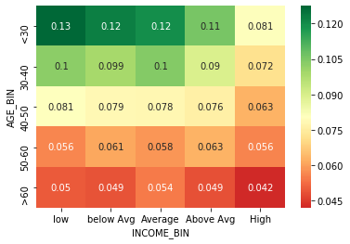
Age Vs Income for Defaulters
Its clear from the above graph that defaulters belong to low-Average salary and from 20-40 range age group.
The best category to approve loan are elder people(50 & above) and average-high income.

Slide 24
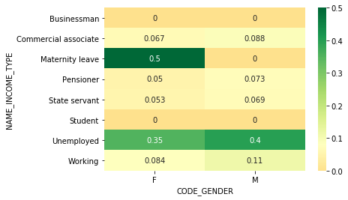
Gender Vs Income Type for Defaulters
Default categories include- people who are in maternity leave & unemployed people.
Working Men also not a good category to provide loan
Good category to provide loan - business people, female pensioner , female state servant.
Students are not considering because it may be education loan.

Slide 25
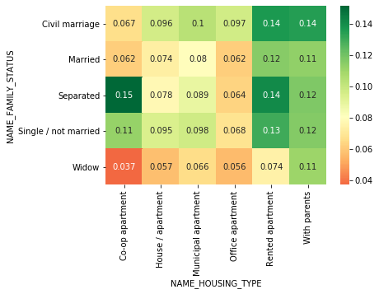
Housing Type Vs Family Type for Defaulters
People staying in Rented apartment or with parents are more likely to default.
Separated people also not a good option.

Slide 26
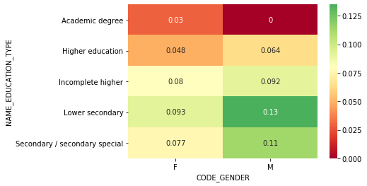
Gender Vs Education Type for Defaulters
Male person with lower education likely to belong to defaulters.
Females with higher education is a good option to provide the loan.

Slide 27
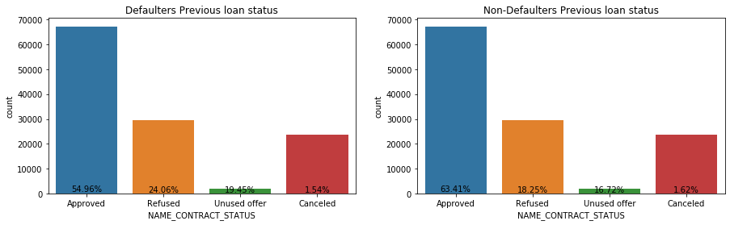
Analysis on Previous Application – Contract status Vs Target
In defaulter segment above 50 % of client have approved loan earlier. And in non-defaulter segment have 18% refused loans.
More clients who have approved loans earlier belong to non-defaulted segment.

Slide 28
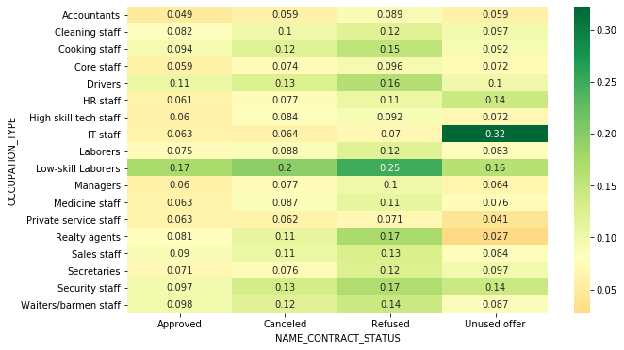
Occupation Type Vs Contract Status Vs Target
Most of the clients who have refused loans earlier are belonging to defaulter group.
Low skill laborers are more likely to default.

Slide 29
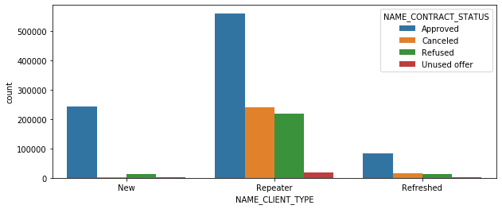
Client type Vs Contract Status
Repeated customer is mainly applying for loan.

Slide 30
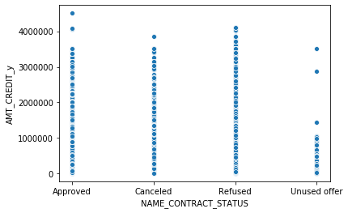
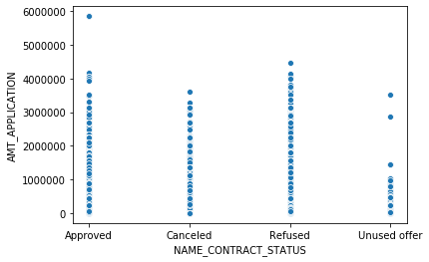
Amount credit & Amount applicationVs Contract Status
High credit and total amount loans mostly rejected previously.

Slide 31
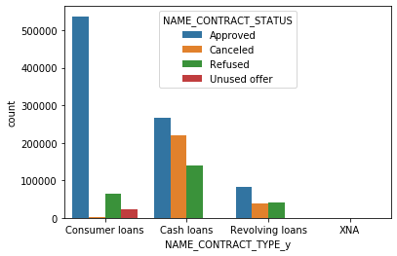
Contract Type Vs Contract Status
Consumer loans carry the highest approval rate.

Slide 32
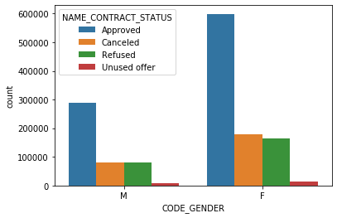
Gender Vs Contract Status
Females are mainly applying for loan and getting approval as well.

Slide 33
Insights:
Important variable which differentiate the defaulters and non-defaulters:
AMT_TOTAL_INCOME - People with high income are good category to provide loan.
CODE_GENDER - Females carry a lesser tendency to become a defaulter.
NAME_EDUCATION_TYPW - People with high education is the best category to provide loan.
DAYS_BIRTH – Above 40 clients are good category to provide loan.
NAME_FAMILY_STATUS - Single people are more likely to be defaulters.
NAME_HOUSING_TYPE - People having housing/apartments are good category to provide loan.
DAYS_EMPLOYED - People with more work experience are best category to provide loan.
EXT_SOURCE_2 - People with high external score are good category to provide loan.
FLAG_OWN_CAR & FLAG_OWN_REALTY - Owning a car or realty is a plus point.
INCOME_TYPE - Commercial associate/pensioner/businessman are good options to provide loan.
AMT_CREDIT or AMT_GOODS_PRICE - People having high amount of credit or goods price have lesser tendency to default.
NAME_CONTRACT_STATUS – Clients with prior approved loans have higher repayment ability.

Slide 34
Category which tend to be in Defaulter:
Young people with low income.
People who are in maternity leave & unemployed
People who are in rented apartments/ with parents
Single/civil marriage people also not a good option
Males with lower education
Low skilled laborers
People who have refused loans earlier
Category having highest repayment ability:
Elder pensioners
Female with higher education
Older people with higher income
Loan with high credit or goods price
People who have approved loans and repeater earlier
Businessman, female pensioner , female state servant

Slide 35
Thank you.

